Slide 1
Cloaking contact-fingers and bus-bars on solar cells

Slide 2
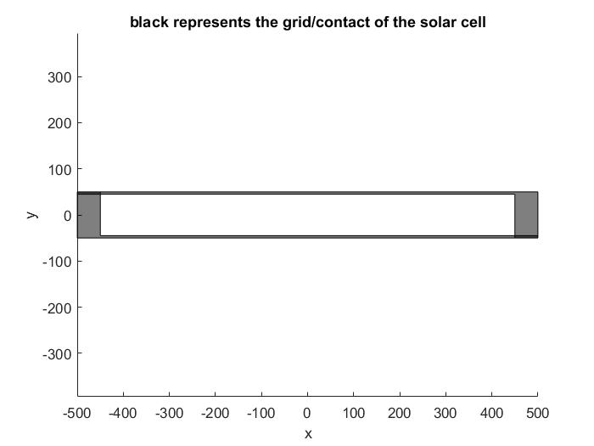

Slide 3
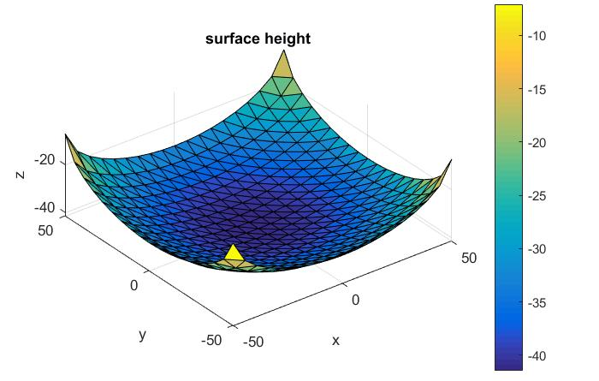
Surface for squared cell example

Slide 4
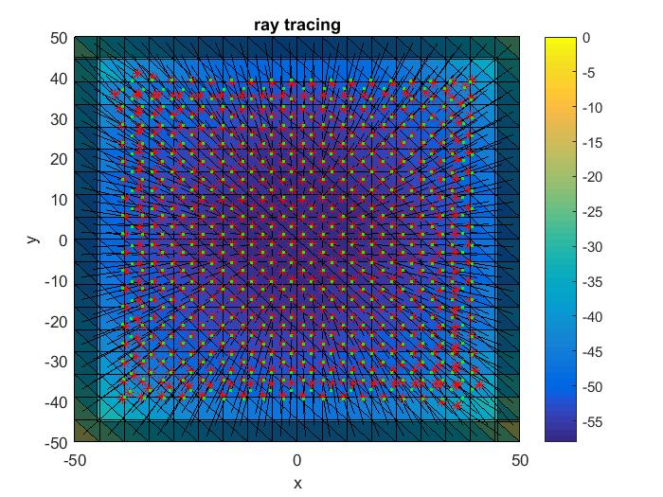
Squared- optimised for normal incident

Slide 5
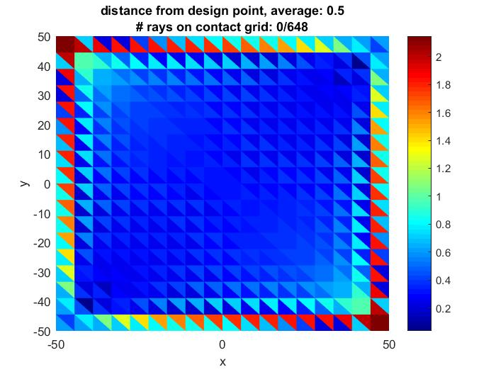
Squared- optimised for normal incident

Slide 6
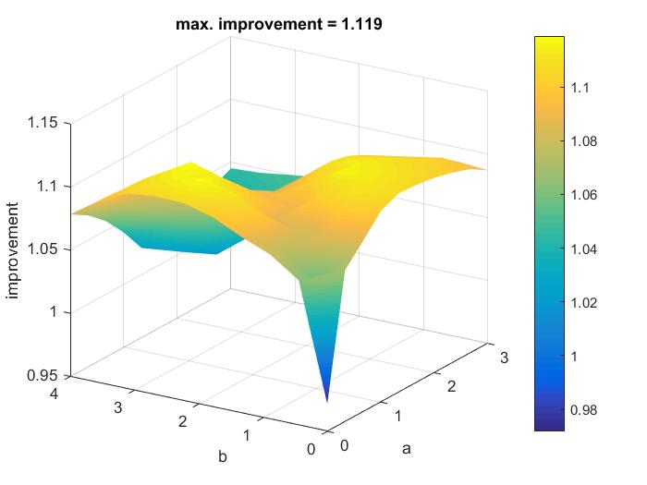
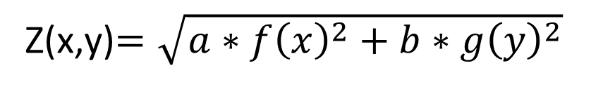
Dependence of Parameter a and b for 50 x 50 cell (squared)
Z(x,y)$=\sqrt{a∗f{\left(x\right)}^{2}+b∗g{\left(y\right)}^{2}}$
Standard Parameter for rx1,rx2,ry1,ry2 used (optimal Parameter of the 1D- case)

Slide 7
Rectagular Size {x,y}={500,50} with nx=50 and ny=5
a | b | y0x | y0y | rx1 | ry1 | P (annual Improvement) | Opt. | {nalphas,nbetas}
2.07 | 5.00 | 49.77 | 55.54 | 51.00 | 9.46 | 1.1371 | annualImpr. | {10,10}
2.07 | 5.00 | 49.77 | 55.54 | 51.00 | 9.46 | 1.1101 | annualImpr. | {20,20}
1.9 | 2.0 | 75 | 70 | 50 | 5 | 1.1071 | normalinc. | {10,10}
1 | 0 | 50 | 0 | 50 | 0 | 1.1025 | only f(x) | {10,10}
0 | 1 | 0 | 5 | 0 | 5 | 1.0789 | only g(y) | {10,10}
Squared Size {x,y}={50,50} with nx=ny=30
a | b | y0x | y0y | P (annual Improvement) | optimisation | {nalphas,nbetas}
0.6 | 1.7 | 5.5 | 6.0 | 1.1153 | annualImpr. | {10,10}
1.9 | 1.9 | 9 | 9 | 1.0225 | normalinc. | {10,10}
1 | 0 | 5 | 0 | 1.1019 | only f(x) | {10,10}
0 | 1 | 0 | 5 | 1.1031 | only g(y) | {10,10}

Slide 8
Simulations with the following Ansatz:
Continuous surface using One-dim solution
Rectangular cells → max. 13.71 % annual Improvement
Squared cells → max. 11.83 % annual Improvement
Not working good with respect to angular-acceptance
Not writable because we need to write too large Volume with DLW

Slide 9
Fresnel-design: How to construct?
y
Dividing x/y plane into pixels
Calculate Normal vector for every midpoint of every pixel for normal Incidence
x

Slide 10
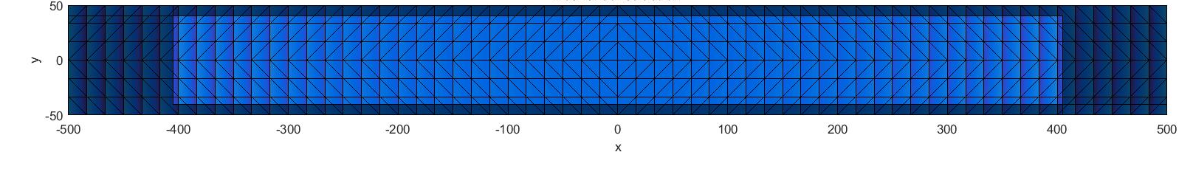
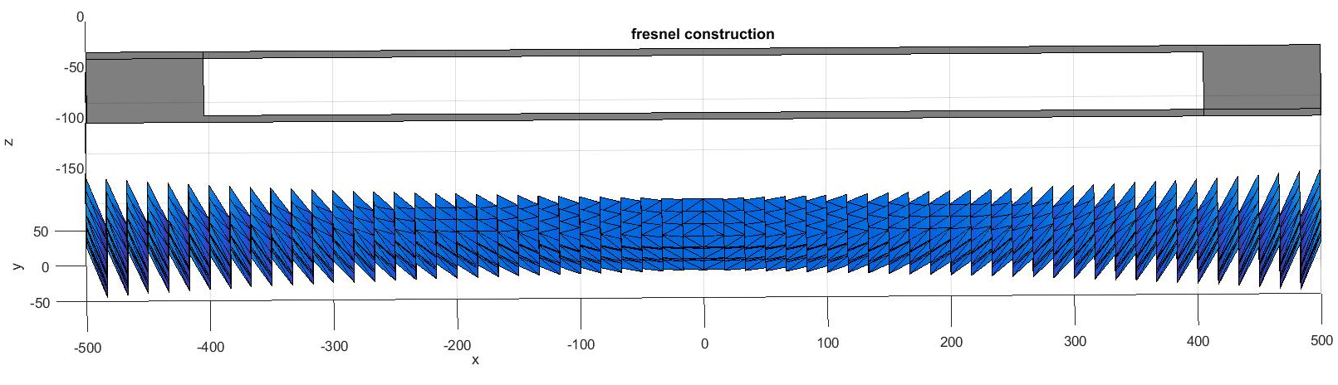
Fresnel-construction 60x6 pixel

Slide 11
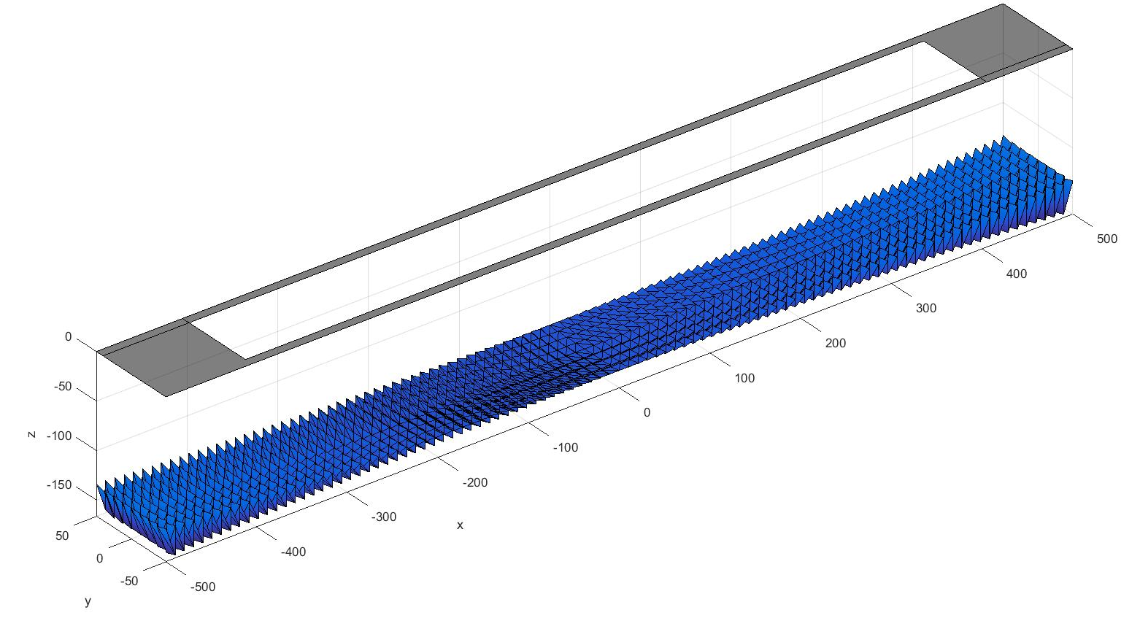
Fresnel-surface construction with 98x8 pixel (h0=150)

Slide 12
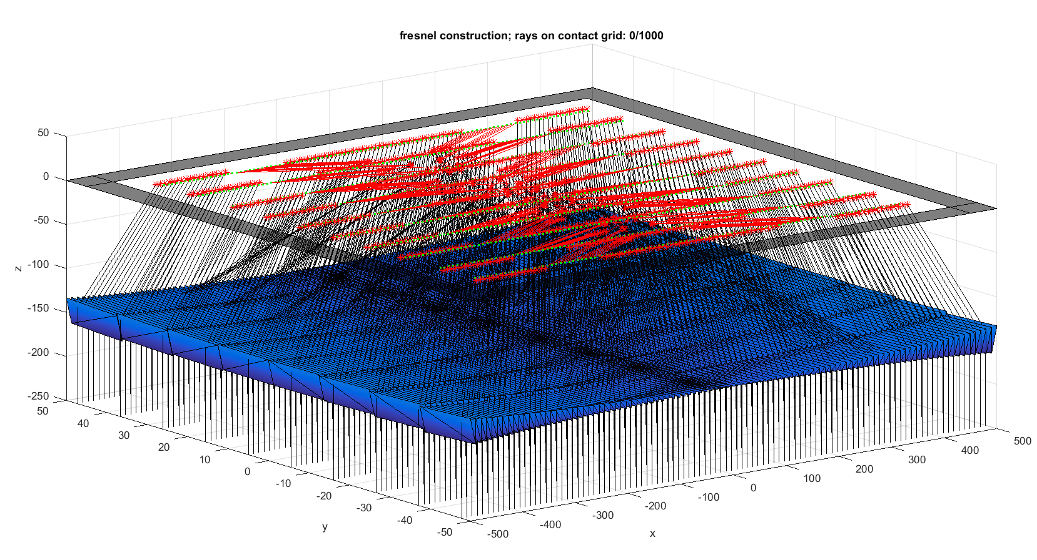
Fresnel- Ray tracing with 98x8 pixel (h0=150)

Slide 13
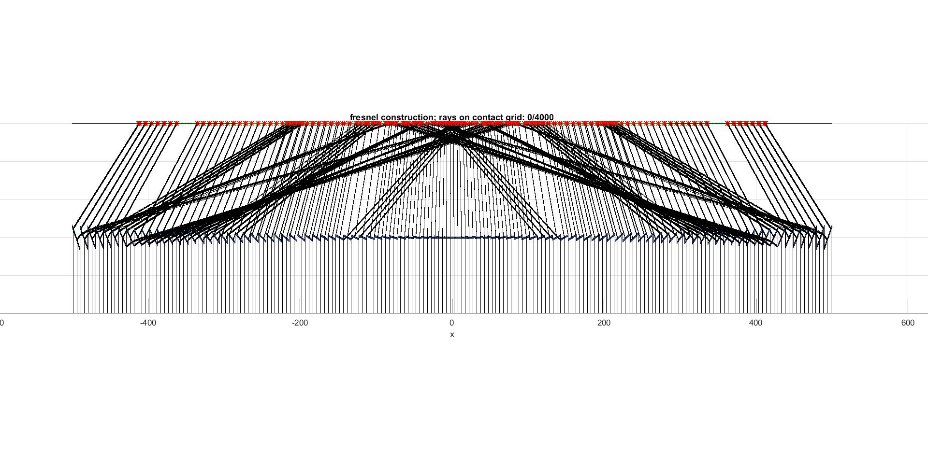
Fresnel- Projection of all rays to c/z-plane (98x8 pixel and 4000 rays, h0=150)
z
0
-100

Slide 14
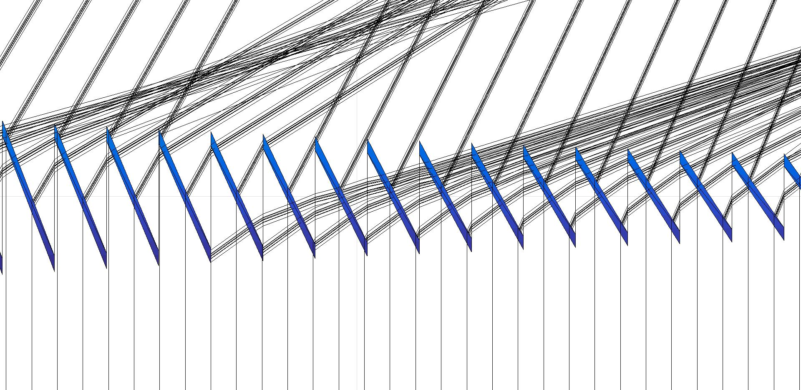
Fresnel- Projection of all rays to c/z-plane (98x8 pixel and 4000 rays,h0=150) – ZOOM IN

Slide 15
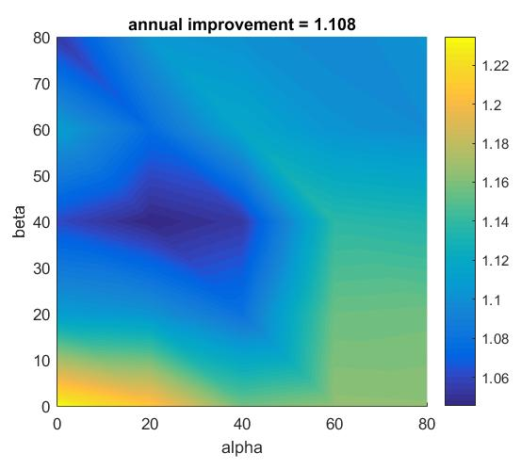
Angular performance of Fresnel optic
Parameter:
h0=150
Pixel=98x8
Raynumber=4000

Slide 16
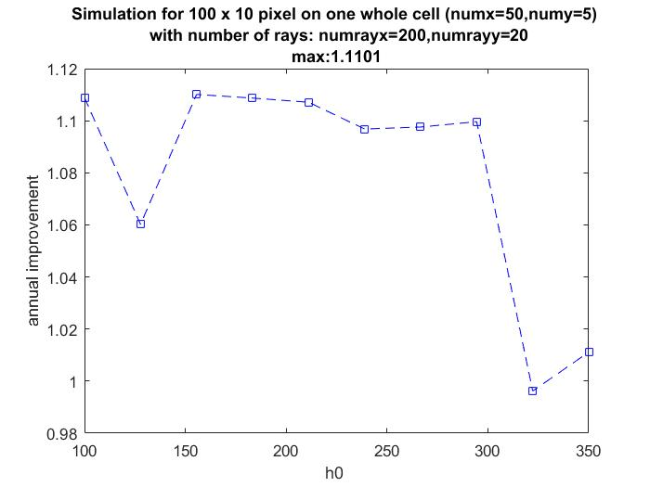

Slide 17
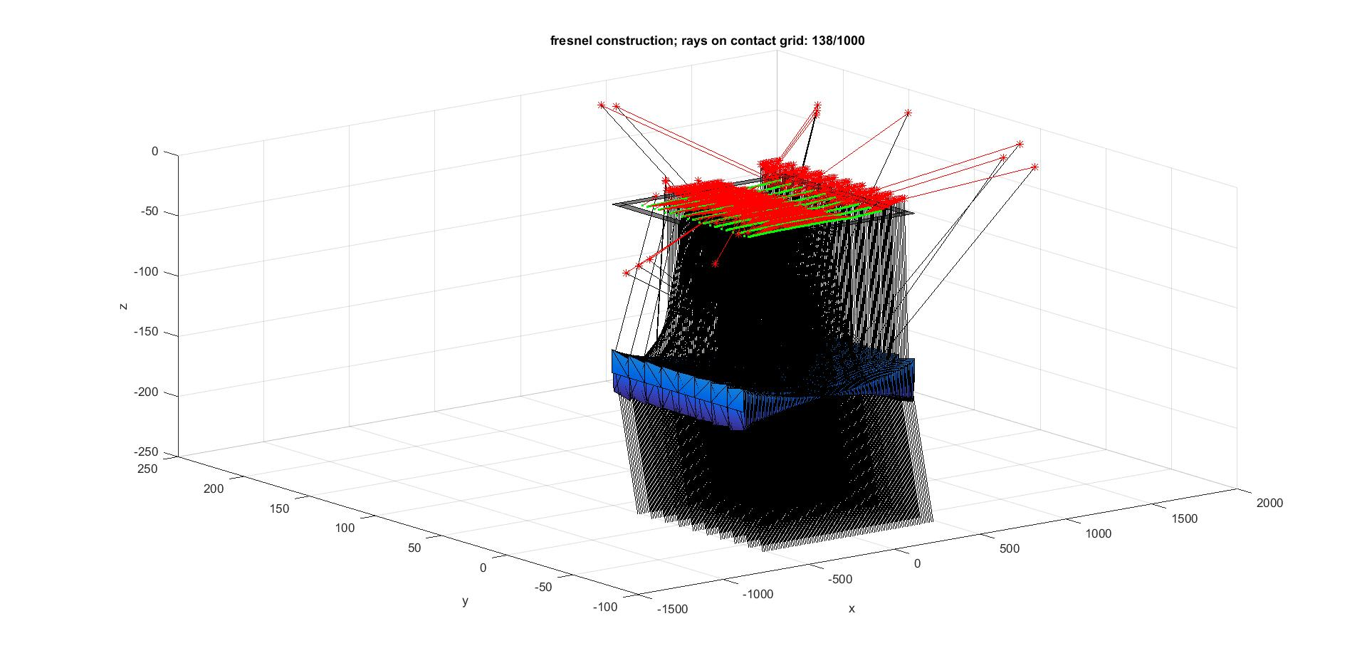
Fresnel, 98x8 Pixel, h0=140,alpha=beta=10

